Slide 1
Point Forces
Dr. Jacob Moore
Associate Professor of Engineering
Penn State Mont Alto

Slide 2

Point Forces
A point force is any force with a single point of application.
These forces are represented by vectors and each point force has three important characteristics.
A magnitude
A direction
A (single) point of application
$$F=100N$$

Slide 3
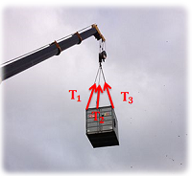
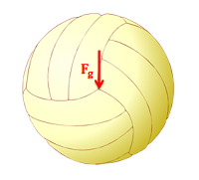
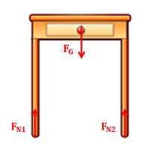
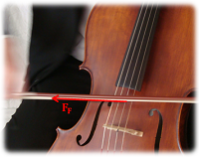
Point Forces
Though almost every force is actually applied over some area or volume, we approximate many forces as point forces.

Slide 4
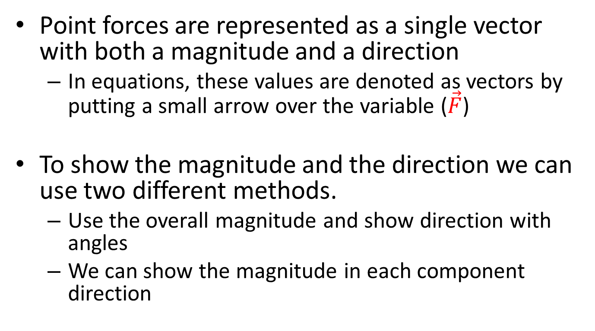
Point Forces as Vectors
Point forces are represented as a single vector with both a magnitude and a direction
In equations, these values are denoted as vectors by putting a small arrow over the variable ($\vec{F}$)
To show the magnitude and the direction we can use two different methods.
Use the overall magnitude and show direction with angles
We can show the magnitude in each component direction

Slide 5
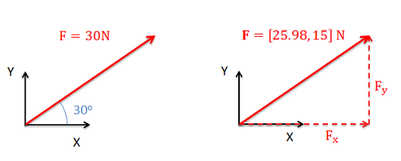
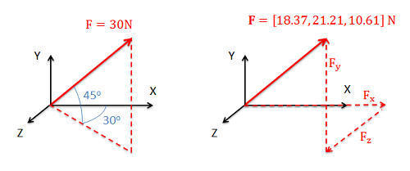
Point Forces as Vectors
In two dimensions
In three dimensions
magnitude and angle
component form
magnitude and angle
component form

Slide 6

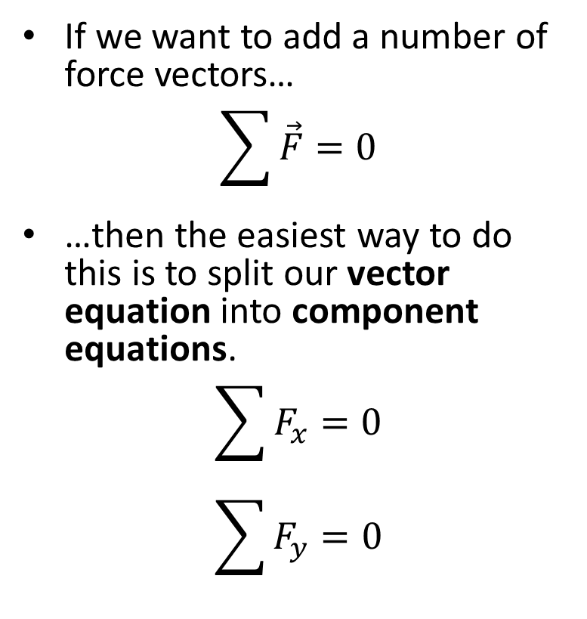


Adding Vectors
If we want to add a number of force vectors…
$$\sum{\vec{F}}=0$$
…then the easiest way to do this is to split our vector equation into component equations.
$$\sum{F_{x}=0}$$
$$\sum{F_{y}=0}$$
$$F_{1}$$
$$F_{3}$$
$$F_{2}$$

Slide 7
Thanks for Watching
See other engineering mechanics videos and access the full tool at…

